Slide 1
MULTI-CUT REBAR(16)
Advisor : Prof. K.C.Chang
Presenters : You-Ran Nai
Notes:
Try 講清楚脈絡

Slide 2
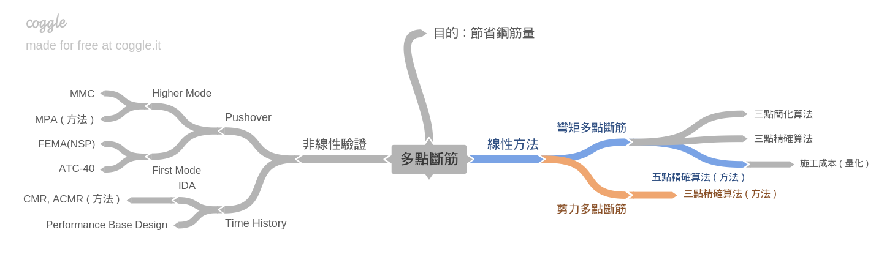
Closed 2 Project

Slide 3
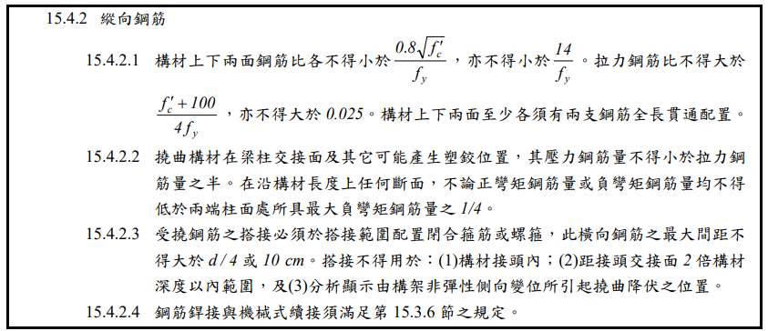
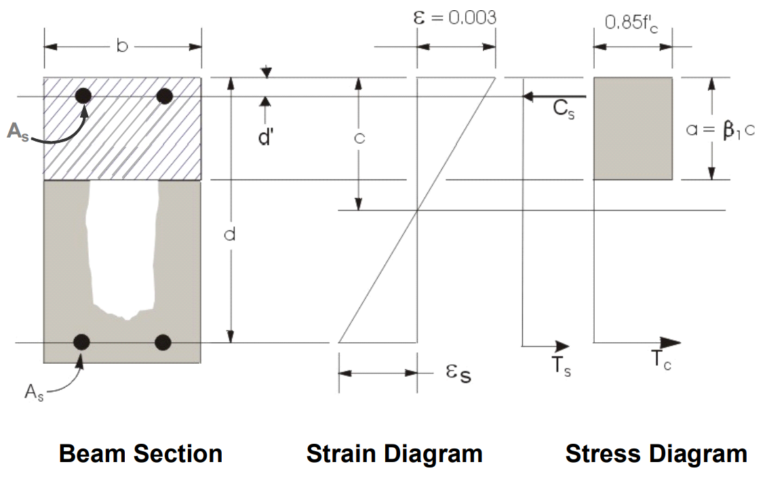
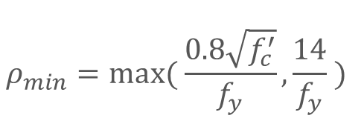
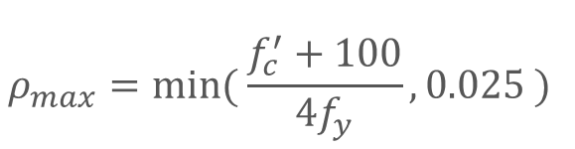
Flexural Reinforcement
$$ρ_{max}=min⁡( \frac{f_{c}^{′}+100}{4f_{y}},0.025 )$$
$$ρ_{min}=max⁡( \frac{0.8\sqrt{f_{c}^{′}}}{f_{y}},\frac{14}{f_{y}} )$$

Slide 4
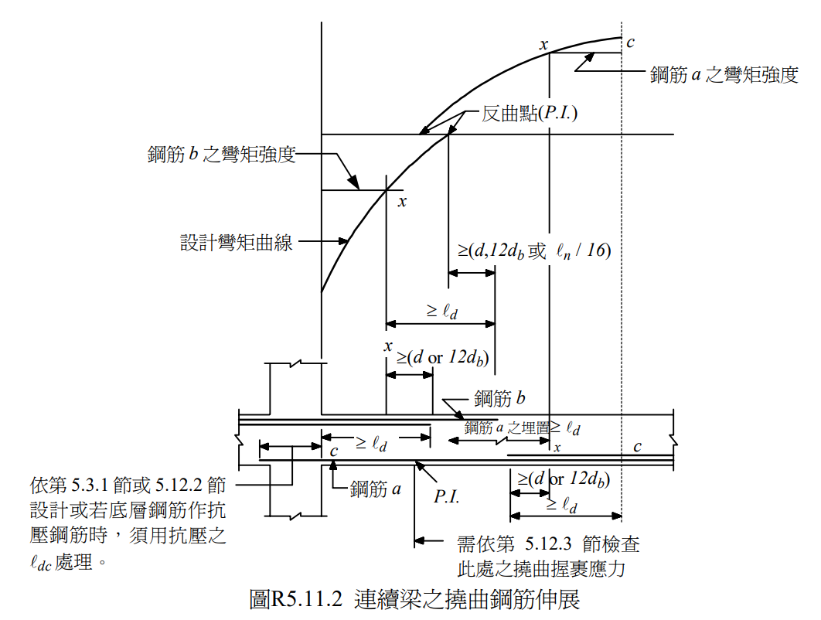
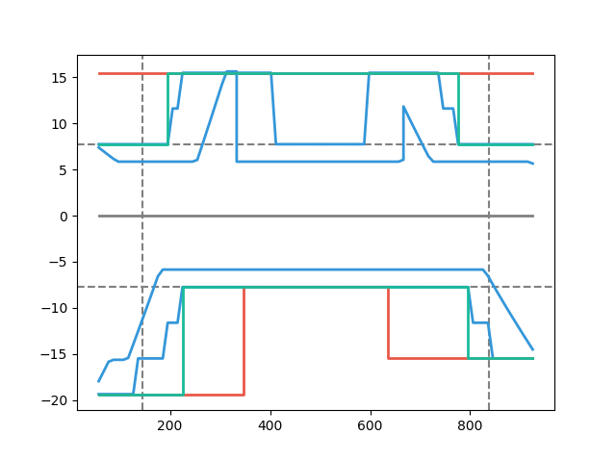
Development Length

Slide 5
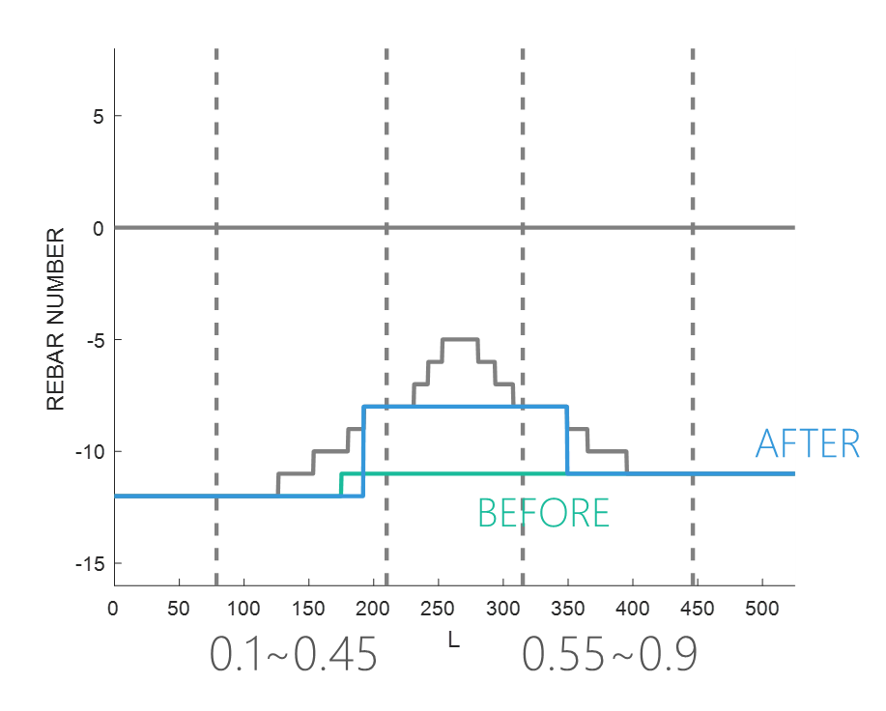
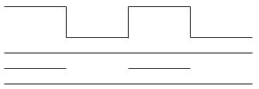

Combinations
0.1
0.9
漸進式退縮
0.1
0.45
0.55
0.9
Notes:
GA 演算法

Slide 6
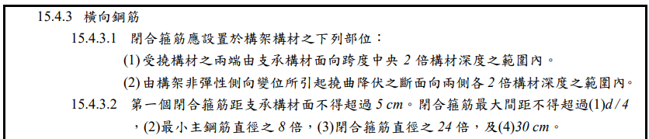
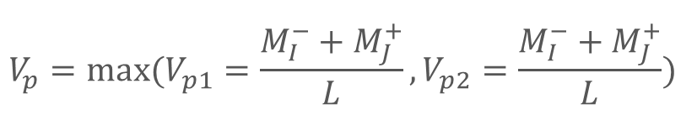

Shear Reinforcement
$$V_{u}=V_{p}+V_{D+L}$$
>2h, Consider Vc
$$V_{p}=max⁡(V_{p1}=\frac{M_{I}^{−}+M_{J}^{+}}{L},V_{p2}=\frac{M_{I}^{−}+M_{J}^{+}}{L})$$
Combinations
2h
2h

Slide 7
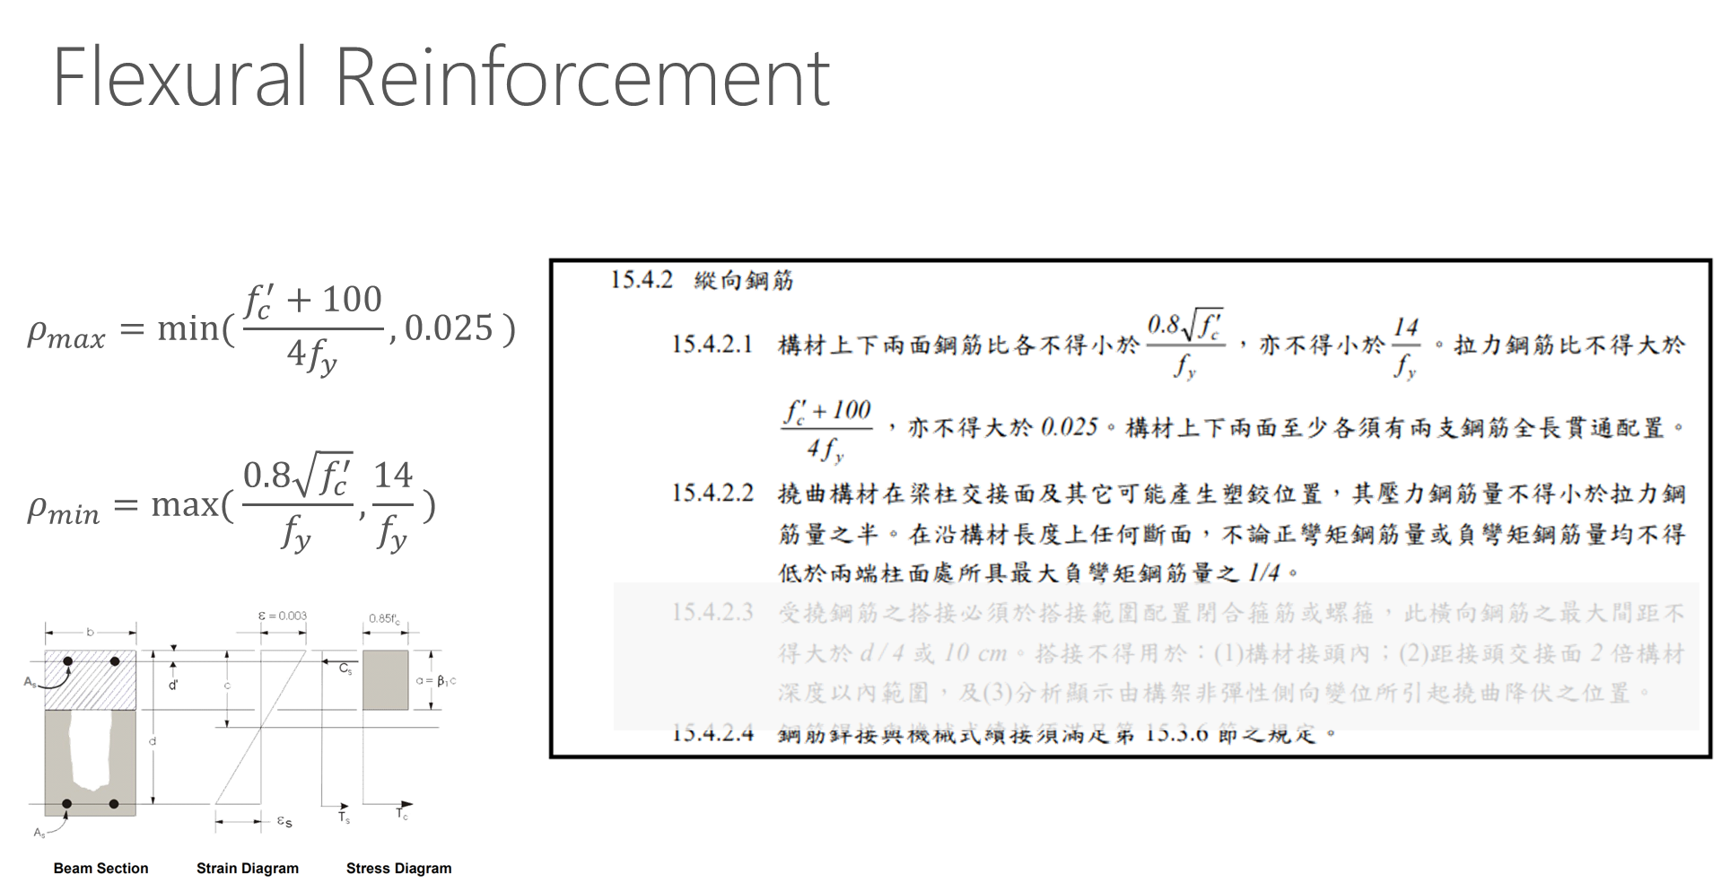
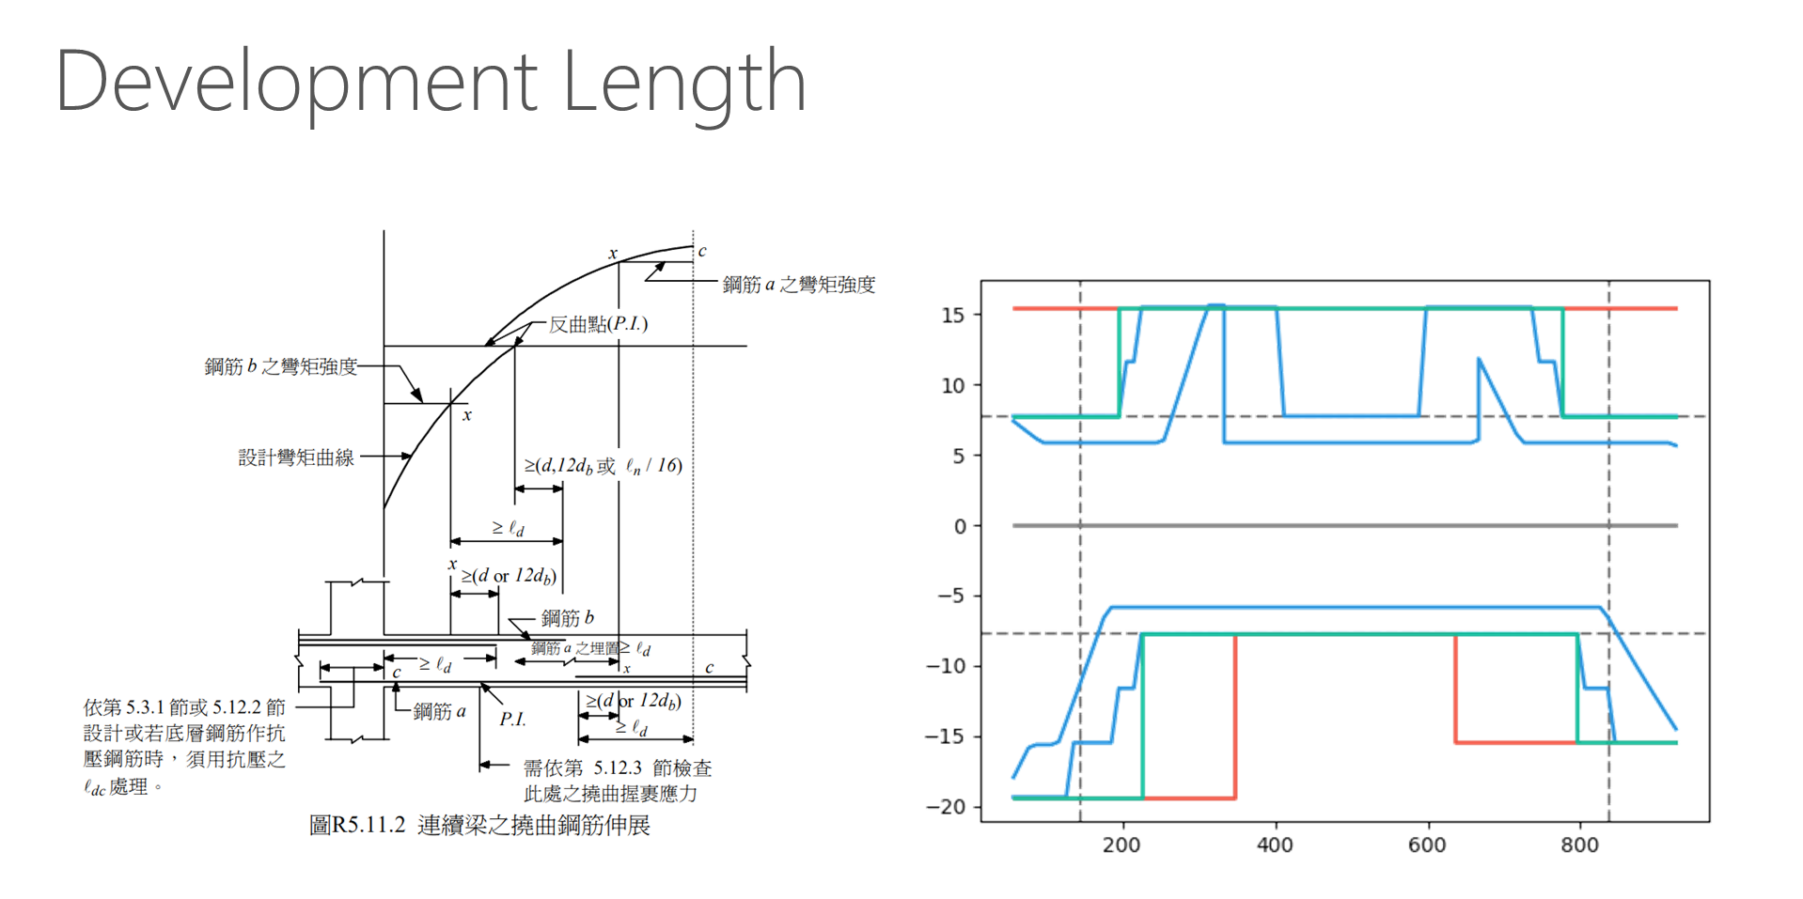
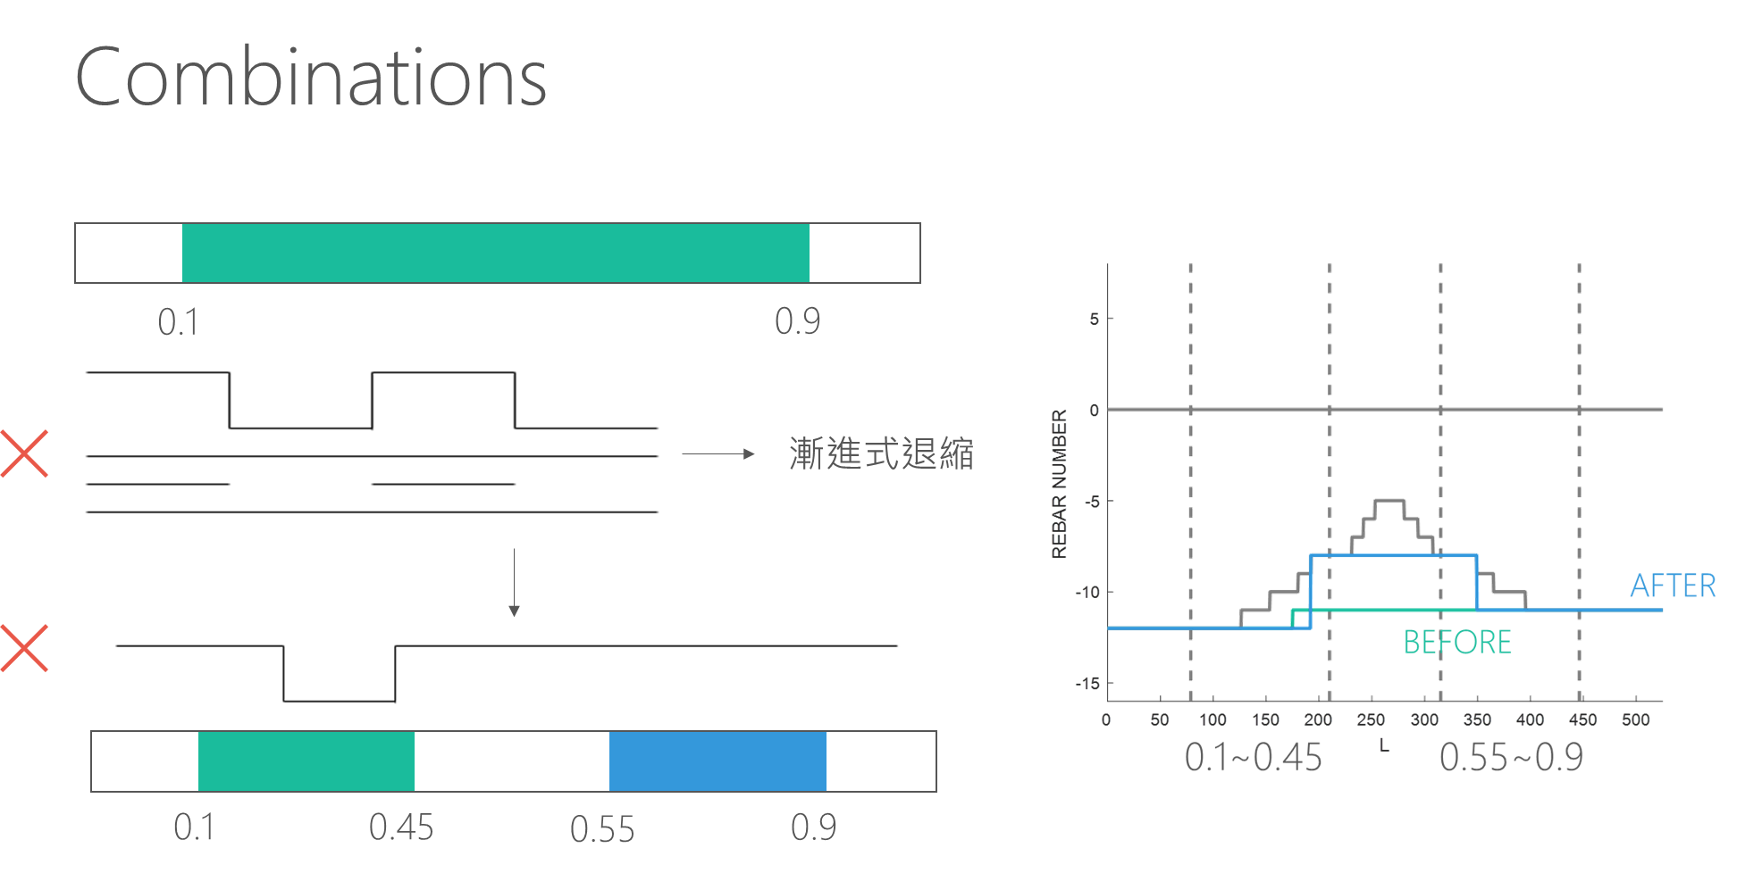
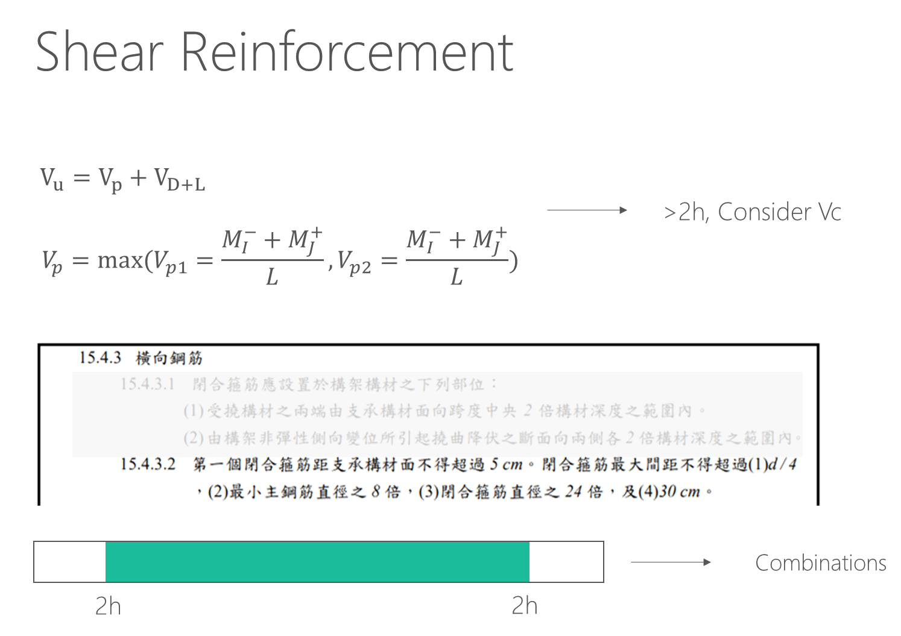

Slide 8
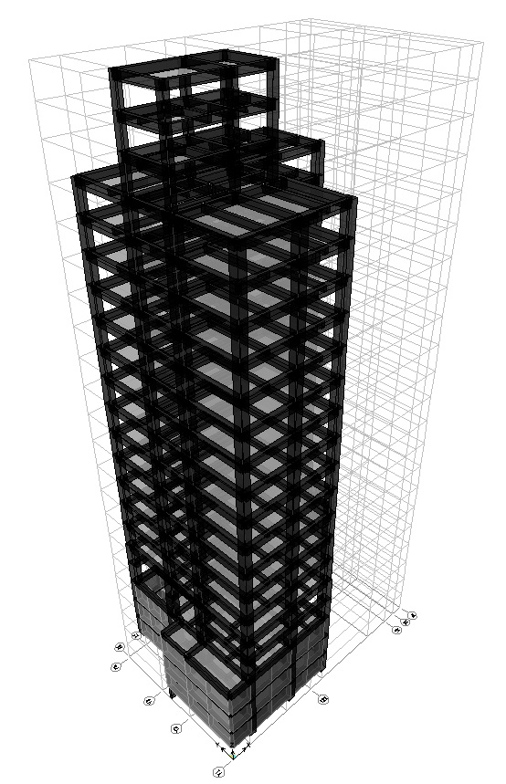
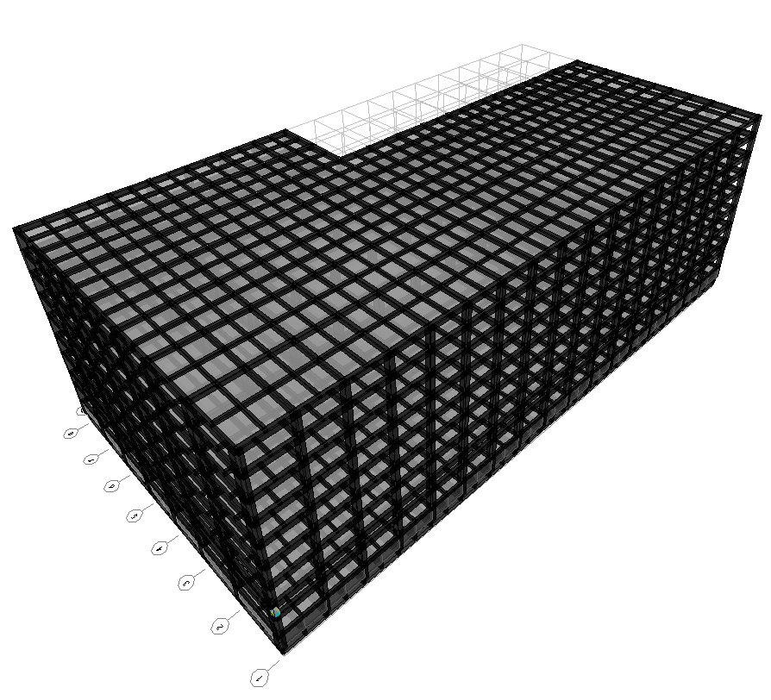
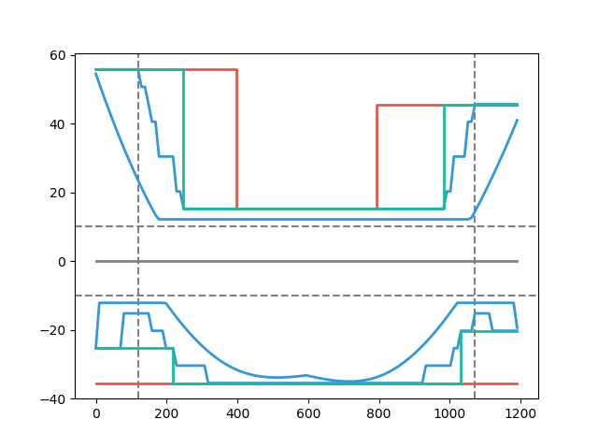
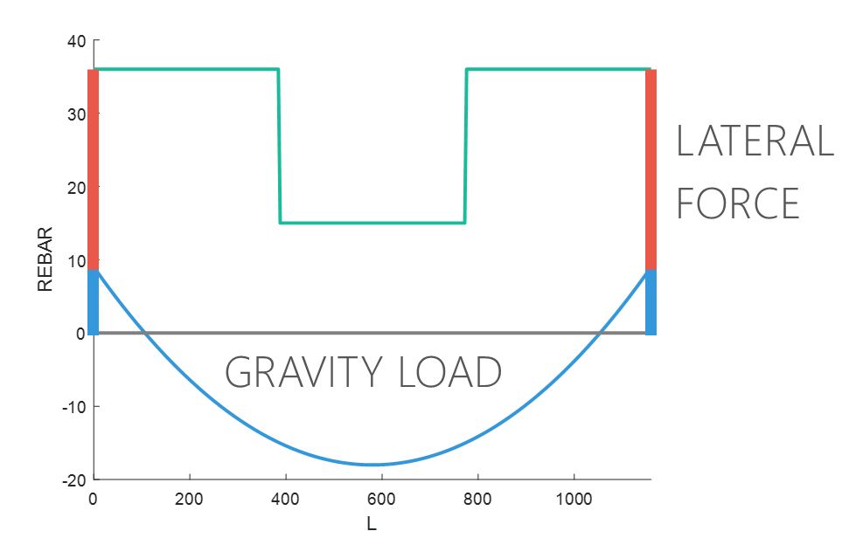
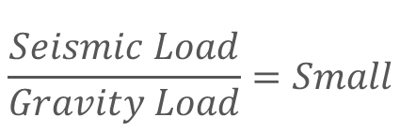
Moment Decay
&
Short Ld
$$\frac{Seismic Load}{Gravity Load}=Small$$
Beam Length
Notes:
下層筋都有可能

Slide 9
11 Models
+
Notes:
27=>11

Slide 10
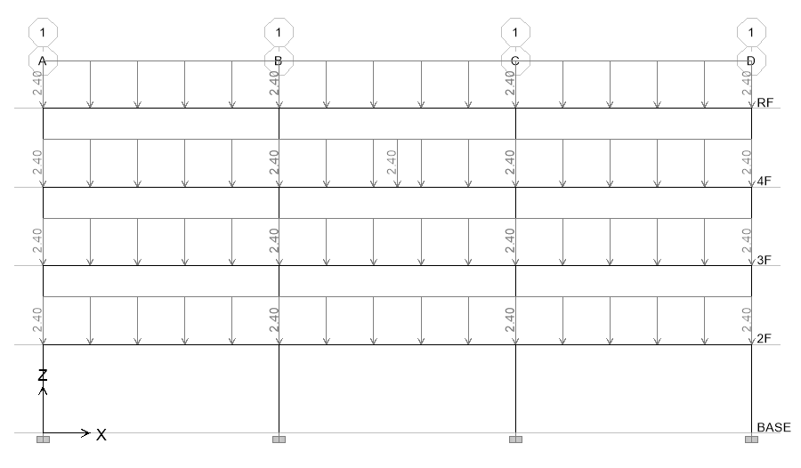
Model Assume
Notes:
混凝土強度越高效果越好

Slide 11
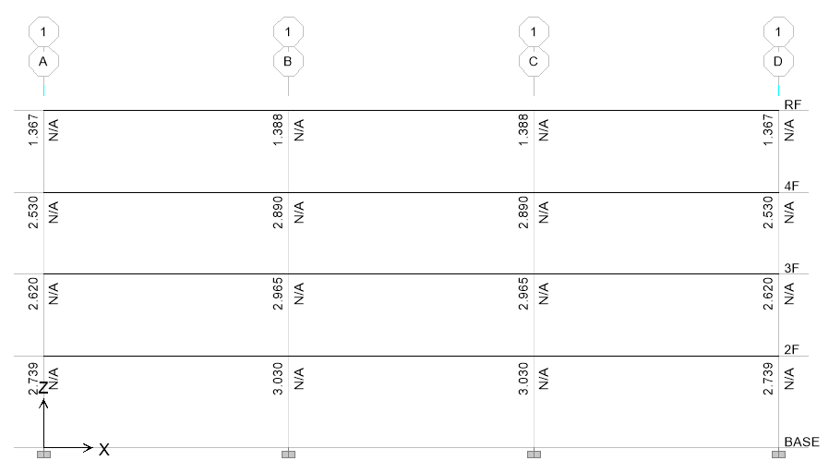
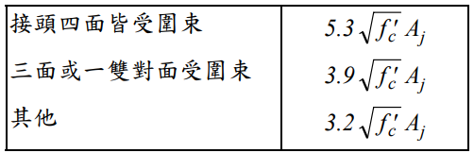
Model Design Problem
Roof Strong Column Weak Beam
Joint Shear

Slide 12
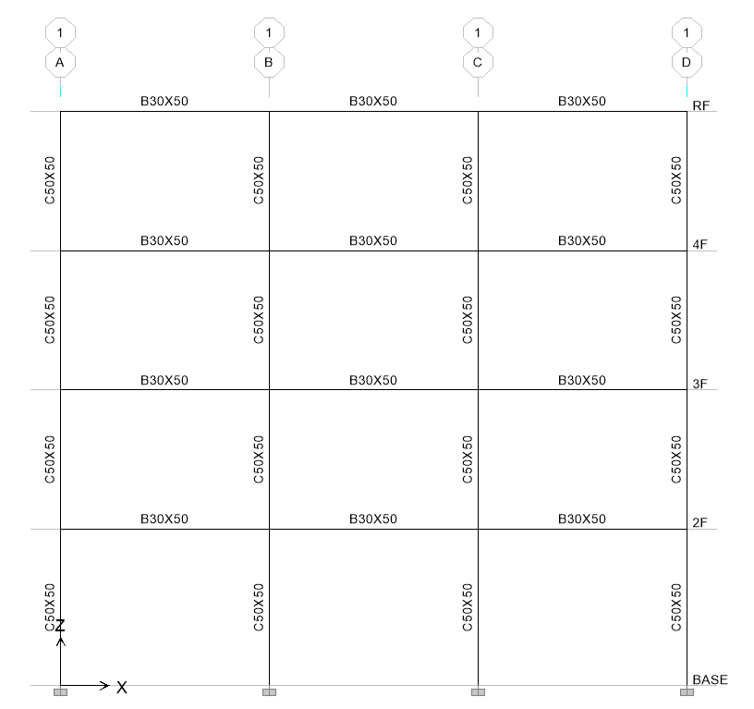
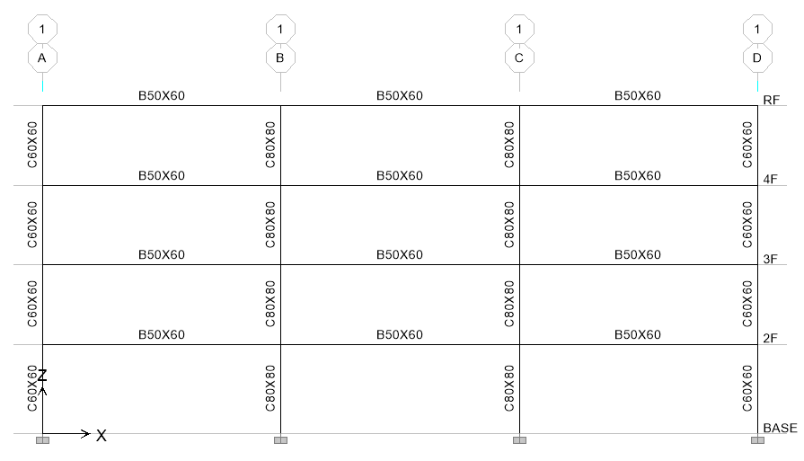
Model Design Problem
6m B25X40, C50X50
12m B50X60, C60X60, C80X80

Slide 13
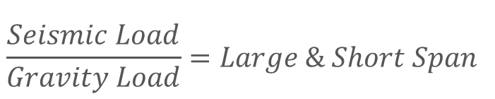
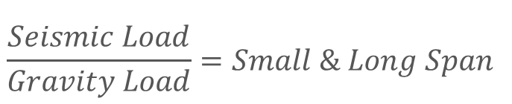
Evaluation
$$\frac{Seismic Load}{Gravity Load}=Small \& Long Span$$
$$\frac{Seismic Load}{Gravity Load}=Large \& Short Span$$
Notes:
大部分是直通筋，不太準

Slide 14
Evaluation
3
47.9s
12 支梁
4
3.9min
5
23.1min
6
2.0hr

Slide 15
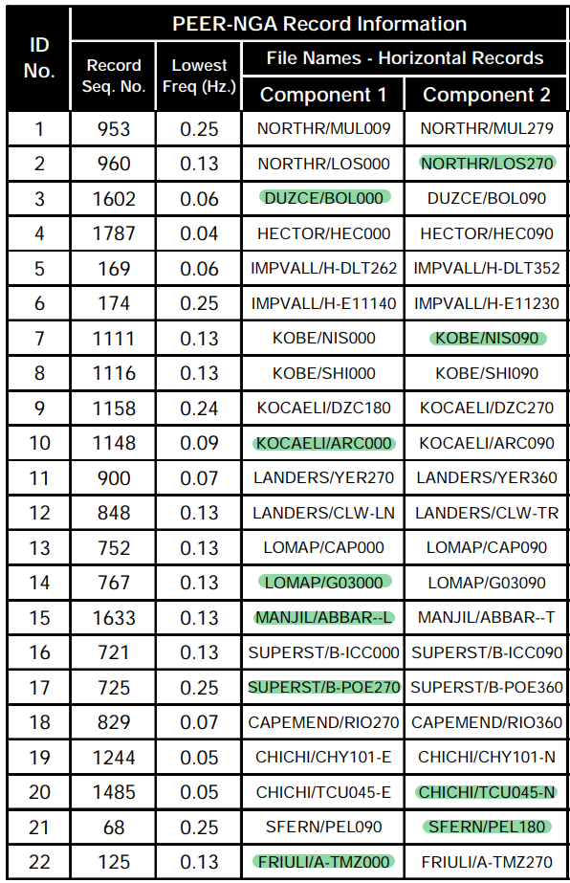

Time History
Find PGA and PGV
Calculate $\frac{PGA}{PGV}$ ratio
Max 10 ratio and no same earthquake

Slide 16
Spectrum
Unscaled
Normalized

Slide 17
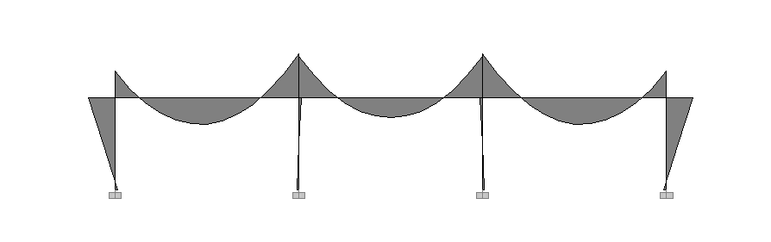
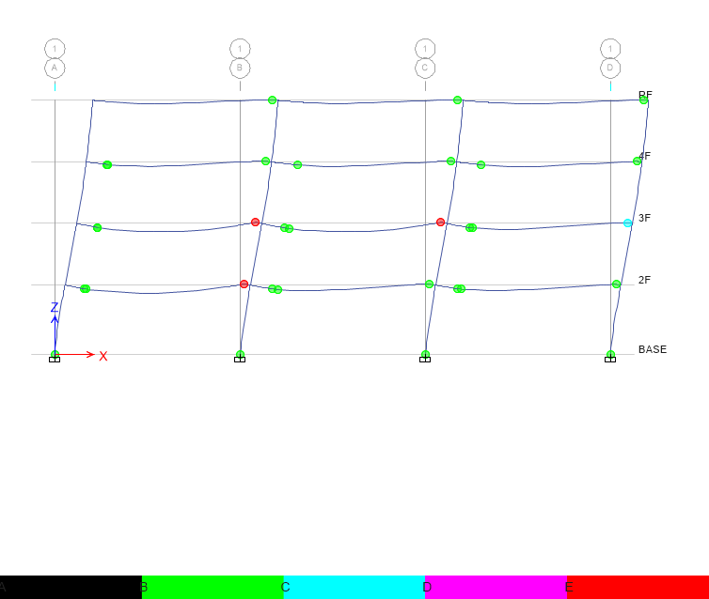
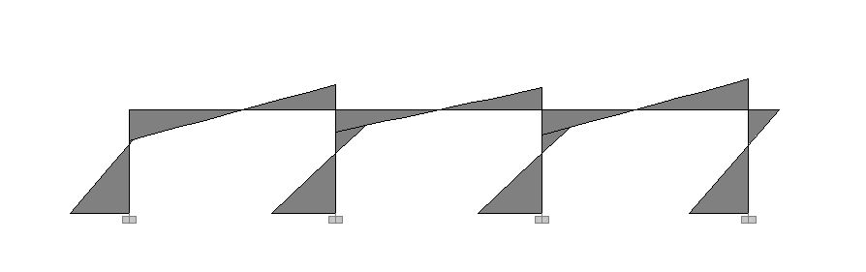
Hinge
Third Hinge
+

Slide 18
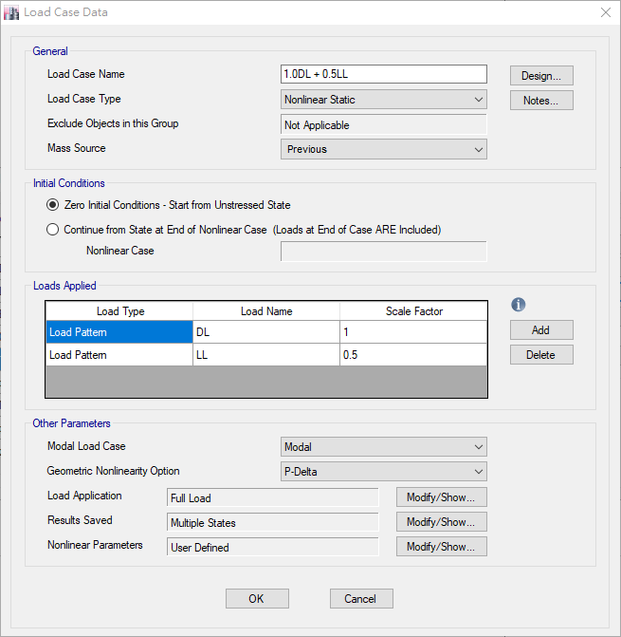
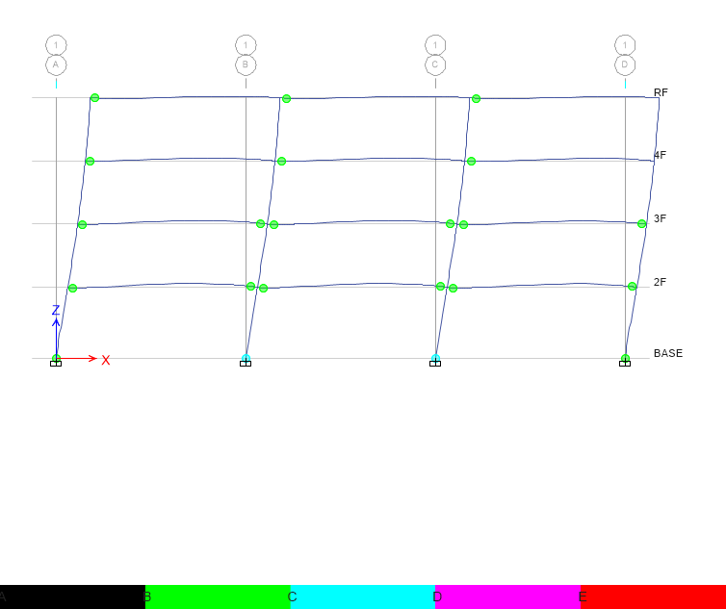
Hinge
Without Initial Conditions

Slide 19
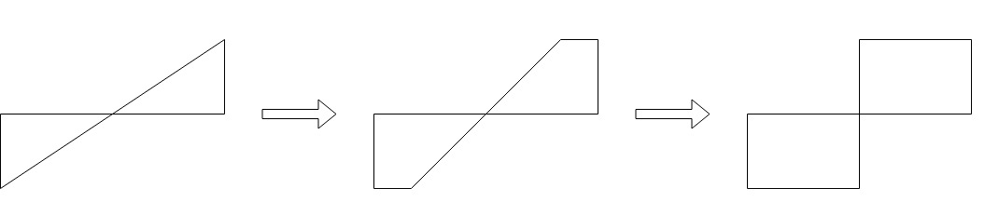
Hinge
一般斷筋要不要也設多個塑角

Slide 20

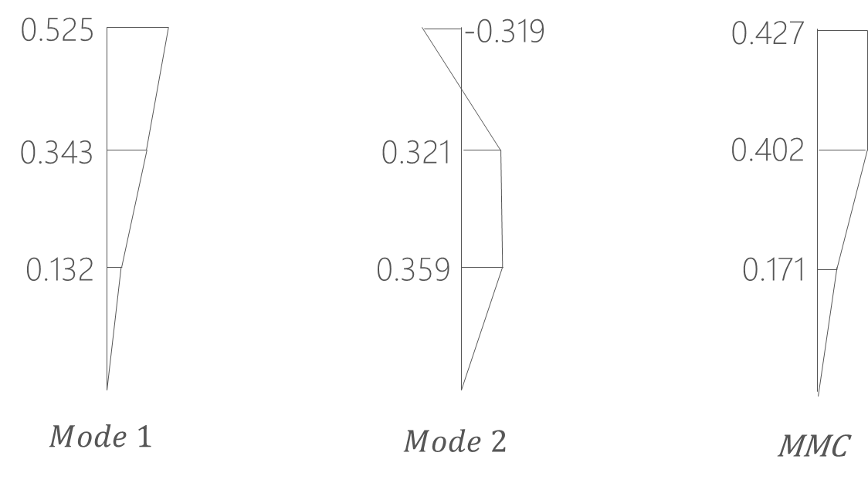
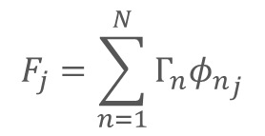
Pushover Load Pattern
Triangle
Multi-Modes Combination
Modal Pushover Analysis
$$F_{j}=\sum_{n=1}^{N}{Γ_{n}{φ_{n}}_{j}}$$
SRSS
Notes:
定義非線性驗證的邊界

Slide 21
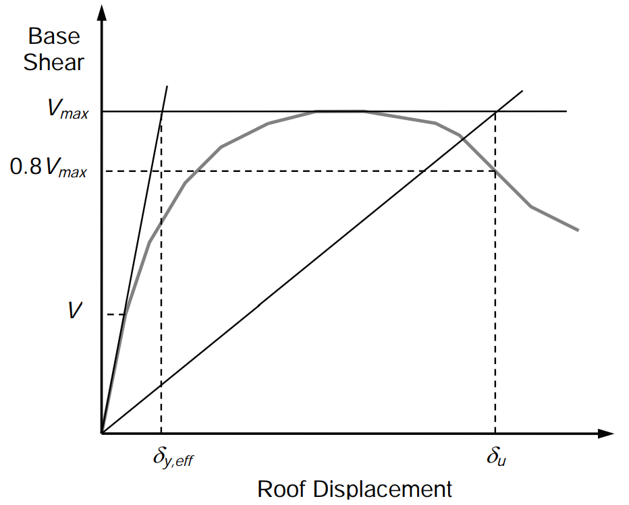
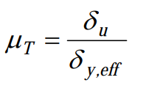
Pushover Result
Hinge

Slide 22
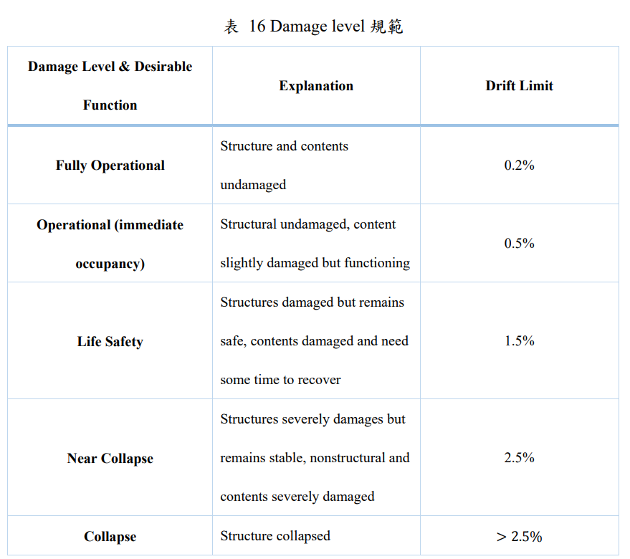
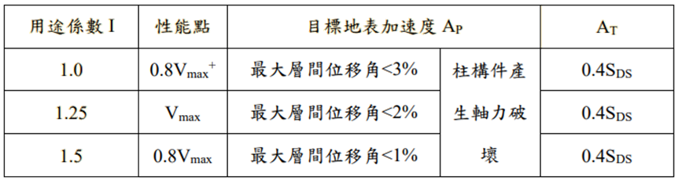
Pushover Result
耐震性能檢測 PGA
ATC-40

Slide 23
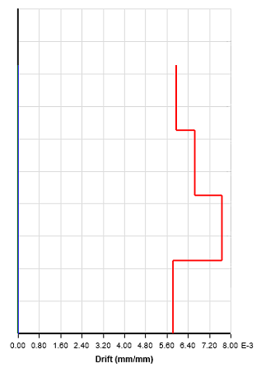
Time history
Story Drift
Scaled to DBE, MCE
DBE < 2%
MCE < 3%

Slide 24
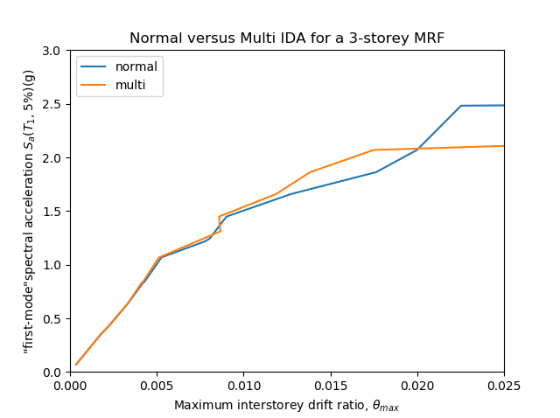
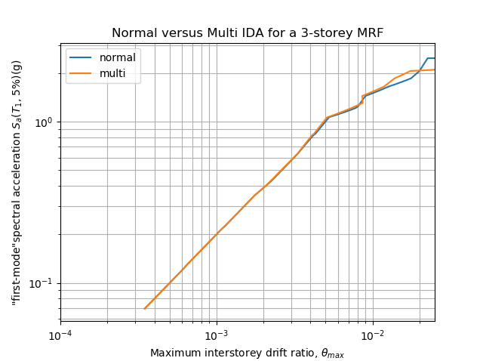
IDA
Limit-State
4% FEMA273
2.5% SEAOC 2000

Slide 25
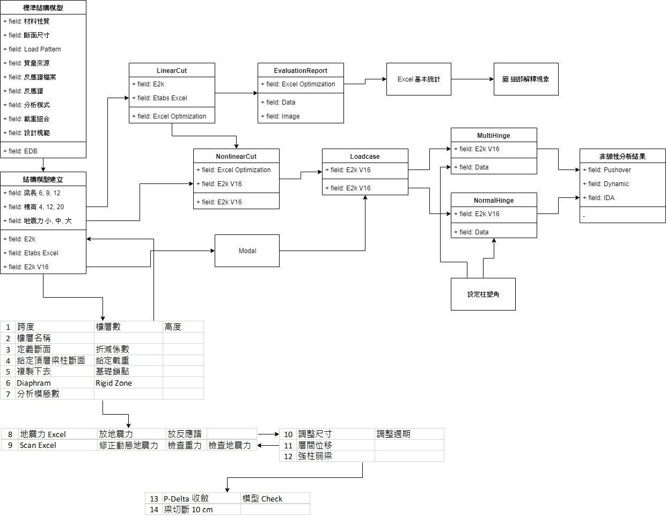
Notes:
寫論文，跑分析。

